Slide 1
Learning & Development Enabling development, Impacting growth…
Hive Programming_Module_1

Slide 2
Module-1 Outline
Motivation to Hive
What is Hive?
Why do we use Apache Hive?
Comparing Hive with traditional database
Hive Architecture
Hive configuration property
Basic SELECT Queries
Submitting Hive Queries
Query Processing in Hive

Slide 3
Motivation to Hive
MapReduce code is typically written in Java
Although it can be written in other languages using Hadoop Streaming API
Requires:
A programmer
Who is a good Java programmer
Who understands how to think in terms of MapReduce
Who understands the problem they’re trying to solve
Who has enough time to write and test the code
Who will be available to maintain and update the code in the future as requirements change

Slide 4
Motivation to Hive (cont..)
Many organizations have only a few developers who can write good MapReduce code
Meanwhile, many other people want to analyze data
Business analysts
Data scientists
Statisticians
Data analysts
What’s needed is a higher-level abstraction on top of MapReduce
Providing the ability to query the data without needing to know MapReduce intimately
Hive address these needs

Slide 5
What is Hive?
Hive is an abstraction on top of MapReduce
Allows users to query data in the Hadoop cluster without knowing Java or MapReduce
Hive provides a SQL-like interface to data stored in an Apache Hadoop based data warehouse.
Hive was originally developed by Facebook for data warehousing ,
Now an open-source Apache Project

Slide 6
What is Hive? (cont..)
Intuitive
Make the structured data looks like tables regardless how it is really stored in Hadoop File system
Hive enables analysis of large data sets using a HiveQL language very much similar
to standard ANSI SQL
Generate specific execution plan for the query
Hive translates the query into Java Map Reduce code and runs the same on Hadoop cluster.

Slide 7
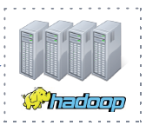
What is Hive? (cont..)
Hive interpreter runs on the client machine
Turns HiveQL statements into MapReduce jobs
Submit those jobs and Execute across a Hadoop cluster
HiveQL Statements
Hive Interpreter/Execution Engine
MapReduce Job
select zipcode,sum(cost) as total from customers
join orders on customers.cust_id=orders.cust_id where zipcode like '50%‘
group by zipcode
order by total desc;
- Parse HiveQL
-Make optimization
- Plan execution
- Generate MapReduce
- Submit jobs to hadoop
- Monitor progress

Slide 8
Why do we use Apache Hive?
More productive than writing complex MapReduce codes
Few lines of HiveQL query might be equivalent to 100 or more lines of Java code
Brings large-scale data analysis to a broader audience
No Software development experience required
Leverage existing knowledge of SQL
Offers interpretability with other systems
Extensible through java and external scripts
Many BI tools supports hive

Slide 9
Comparing Hive with traditional database

Slide 10
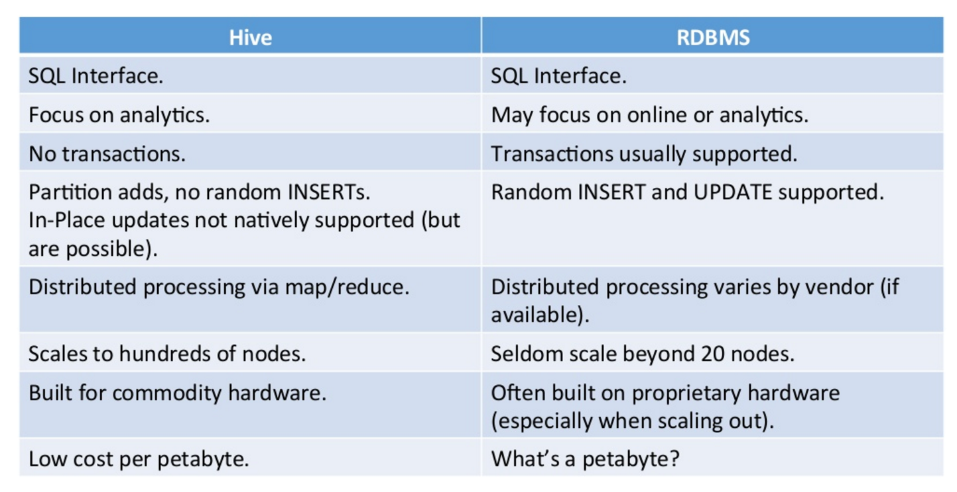
Hive Vs RDBMS

Slide 11
Your Cluster is not your database
Client-server base RDBMS database management systems have many strengths
Very fast response time
support for transactions
Allows modification of existing records
Can serve thousands of simultaneous clients
Hive does not turn your Hadoop cluster into an RDBMS
It simply produce MapReduce jobs from HiveQL queries
Limitations of HDFS and MapReduce still apply
Hive is best suited for Data Warehousing applications where data is structured, static and formatted.
Hive queries have higher latency due to start up overhead as most Hive queries turn out into Map Reduce jobs

Slide 12
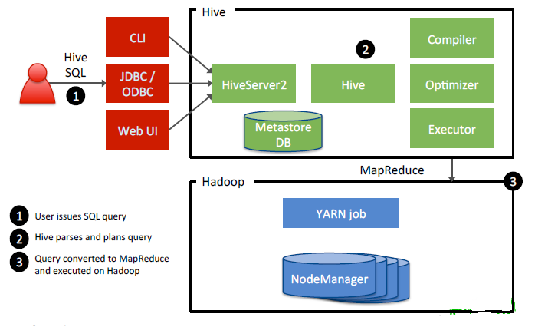
Hive Architecture
Notes:
Hive Architecture
Step 1: Issuing Commands
Using the Hive CLI, a Web interface, or a Hive JDBC/ODBC client, a Hive query is submitted to the HiveServer.
Step 2: Hive Query Plan
The Hive query is compiled, optimized and planned as a MapReduce job. Step 3: MapReduce Job Executes
The corresponding MapReduce job is executed on the Hadoop cluster.

Slide 13
Hive configuration property
Hive configuration files are Primarily written in XML
A number of configuration variables in Hive can be used by the Hive administrator , few of those are mentioned below:
Hive configuration file name is hive-site.xml.
In hive-site.xml. This is used for setting values for the entire Hive configuration For example:
<property>
<name>hive.exec.scratchdir</name>
<value>/tmp/mydir</value>
<description>Scratch space for Hive jobs</description>
</property>

Slide 14
Basic SELECT Queries
Hive supports most familiar SELECT syntax
hive> SELECT * FROM shakespeare LIMIT 10;
hive> SELECT * FROM shakespeare
WHERE freq > 100 ORDER BY freq ASC
LIMIT 10;
Notes:
One nice benefit of Hive is its ability to join data in a simple fashion. The JOIN command in HiveQL is similar to its SQL counterpart. For example, the following statement performs an inner join on two tables:
SELECT customers.*, orders.* FROM customers JOIN orders ON
(customers.customerID = orders.customerID);
To perform an outer join, use the OUTER keyword:
SELECT customers.*, orders.* FROM customers LEFT OUTER JOIN
orders ON (customers.customerID = orders.customerID);
In the SELECT above, a row will be returned for every customer, even those without any orders.

Slide 15
Submitting Hive Queries
Hive CLI
Traditional Hive client that connects to a HiveServer instance
To launch the Hive shell, start a terminal and run
$ hive
Results in the Hive prompt:
hive>
Beeline
A new command line client that connects to a HiveServer2 instance
$ beeline
Hive version 0.11.0-SNAPSHOT by Apache beeline>
Notes:
Submitting Hive Queries
Hive queries are written using the HiveQL language, a SQL-­‐like scripting language that simplifies the creation of MapReduce jobs. With HiveQL, data analysts can focus on answering questions about the data, and let the Hive framework convert the HiveQL into a MapReduce job.
You have two options for executing HiveQL commands:
Hive CLI: The Hive command line interface allows you to enter commands directly in to the Hive shell, or write the commands in a text file and execute the file.
Beeline: a new JDBC client that works with HiveServer2. The Beeline shell works in embedded mode (just like the Hive CLI) and also remote mode, where you connect to a HiveServer2 process using Thrift.
The Hive CLI shell is started using the hive executable:
$ hive -h hostname
hive>
Use the -­‐f flag to specify a file that contains a Hive script:
$ hive -f myquery.hive
Beeline is started using the beeline executable:
$ beeline
Hive version 0.11.0-SNAPSHOT by Apache beeline>
Once Beeline is started, you issue a connect command to connect to a specific HiveServer2 instance:
beeline> !connect jdbc:hive2://hostname:10000 username
password org.apache.hive.jdbc.HiveDriver

Slide 16
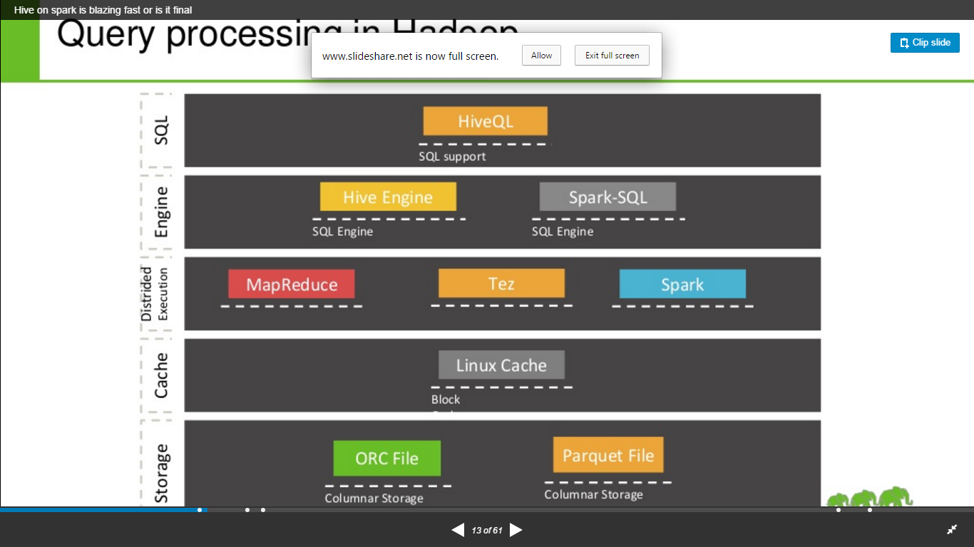
Query Processing in Hive

Slide 17
Module-2 Outline
Hive Data Model
Hive Data Types
Hive Metastore
Types of Tables in Hive - Managed table and External
Hive Metastore
Hive Basics: Creating Tables
Verify Table Types in Hive
Loading Data into a Hive Table

Slide 18

Hive Data Model
How Hive loads data and store it?
All the metadata for Hive tables and partitions are accessed through the Hive Metastore
The HiveQL itself operates on data stored on a filesystem (typically HDFS )
Metastore
1. HiveQL Process Engine gets table structure and location
HDFS
2. HiveQL Execution Engine Query Actual data

Slide 19
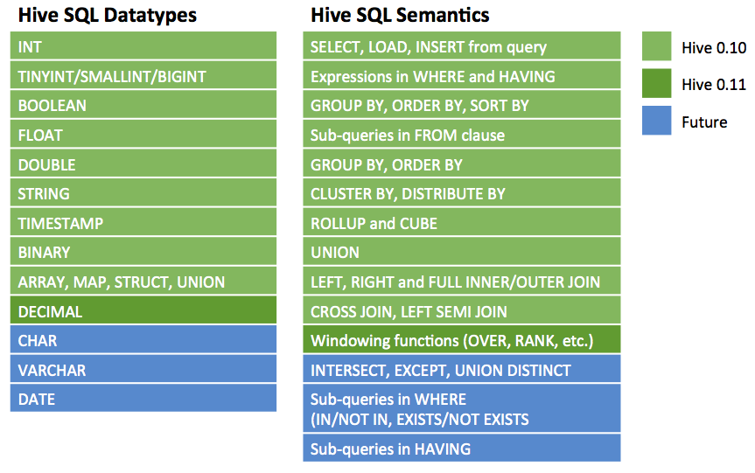
Hive Data Types

Slide 20
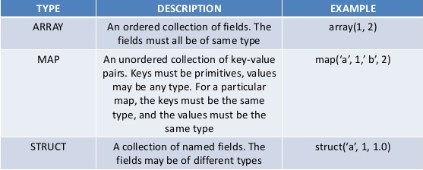
Hive Data Model (cont..)
Hive ‘layers’ table definitions on top of data in HDFS
Tables
Typed columns (int, float, string, boolean and so on)
Also Array , Struct , Union, list: map (for JSON-like data)
Partitions
e.g., to range-partition tables by date
Buckets
Hash partitions within ranges (useful for sampling, join optimization)

Slide 21
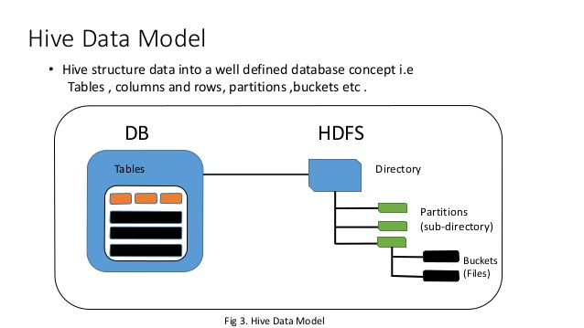
Hive Data Model (cont..)

Slide 22
Hive Metastore
Hive’s Metastore is a database containing table definitions and other metadata
By default, stored locally on the client machine in a Derby database
If multiple people will be using Hive, the system administrator should create a shared Metastore
Usually in MySQL or some other relational database server

Slide 23
Apache Hive
Types of Tables in Hive

Slide 24
Managed table and External table in Hive
There are two types of tables in Hive ,
Managed table
External table
The difference is , when you drop a table, if it is managed table hive deletes both data and meta data, if it is external table Hive only deletes metadata
External table files are accessible to anyone who has access to HDFS file structure and therefore security needs to be managed at the HDFS file/folder level.
Table Creation: by default table is Managed table .If you want to create a external table , you will use external keyword.
Syntax – Managed Table
create table managedemp(col1 datatype,col2 datatype, ....) row format delimited fields terminated by 'delimiter character‘ location '/data/employee‘
Syntax – External Table
create external table managedemp(col1 datatype,col2 datatype, ....) row format delimited fields terminated by 'delimiter character‘ location '/data/employee'

Slide 25
Q & A
What is difference between managed table and external Table?

Slide 26
Hive Basics: Creating Tables
hive> SHOW TABLES;
hive> CREATE TABLE shakespeare (freq INT, word STRING)
ROW FORMAT DELIMITED FIELDS TERMINATED BY '\t'
STORED AS TEXTFILE;
hive> DESCRIBE shakespeare;

Slide 27
Verify Table Types in Hive
How do you check whether existing table is managed or external table?
How do you check whether existing table is managed or external table?
To check that we use describe command like below
Syntax:
describe formatted tablename;
Example: If it is managed table ,you will see
Table Type: MANAGED_TABLE
If it is external table ,you will see
Table Type: EXTERNAL_TABLE

Slide 28
Loading Data into a Hive Table
Hive does not do any transformation while loading data into tables.
Load operations are currently pure copy/move operations that move data files into locations corresponding to Hive tables.
The load command will look for file path in the local file system
If the keyword LOCAL is not specified, then the load command will look for file path in the HDFS
If the OVERWRITE keyword is used then contents of the target table (or partition) will be deleted and replaced by the files referred to by file path
Notes:
For Hive-­‐managed tables, the data is moved into a special Hive subfolders of
/apps/hive/warehouse.
For external tables, the data is moved to the folder specified by the LOCATION
clause in the table’s definition.
The LOAD DATA command can load files from the local file system (using the LOCAL qualifier) or files already in HDFS. For example, the following command loads a local file into a table named customers:
LOAD DATA LOCAL INPATH '/tmp/customers.csv' OVERWRITE INTO
TABLE customers;
The OVERWRITE option deletes any exising data in the table and replaces it with the new data. If you want to append data to the table’s existing contents, simply leave off the OVERWRITE keyword.
If the data is already in HDFS, then leave off the LOCAL keyword:
LOAD DATA INPATH '/user/train/customers.csv' OVERWRITE INTO
TABLE customers;
In either case above, the file customers.csv is moved either into HDFS in a subfolder of
/apps/hive/warehouse or to the table’s LOCATION folder, and the contents of
customers.csv are now associated with the customers table.
You can also insert data into a Hive table that is the result of a query, which is a common technique in Hive. The syntax looks like:
INSERT INTO birthdays SELECT firstName, lastName, birthday
FROM customers WHERE birthday IS NOT NULL;
The birthdays table will contain all customers whose birthday column is not null.

Slide 29
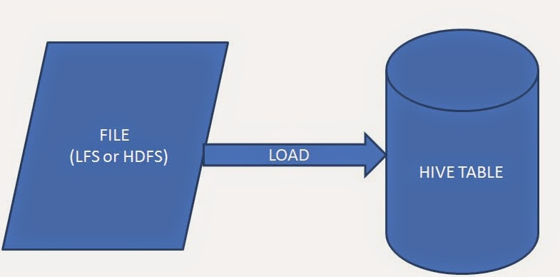
Loading files into Hive tables

Slide 30
Storing Output Results
The SELECT statement on the previous slide would write the data
to the console
To store the results in HDFS, create a new table then write, for
example:
Results are stored in the table
Results are just files within the newTable directory
Data can be used in subsequent queries, or in MapReduce jobs
INSERT OVERWRITE TABLE newTable
SELECT s.word, s.freq, k.freq FROM shakespeare s JOIN kjv k ON
(s.word = k.word) WHERE s.freq >= 5;
Notes:
Storing Results to a File
The following command outputs the results of a query to a file in HDFS. For example:
INSERT OVERWRITE DIRECTORY '/user/train/ca_or_sd/' select
name, state from names where state = 'CA' or state = 'SD';
You can also output the results of a query to a file on the local file system by adding the
LOCAL keyword:
INSERT OVERWRITE LOCAL DIRECTORY '/tmp/myresults/' SELECT *
FROM bucketnames ORDER BY age;

Slide 31
Hive Data: Physical Layout
Hive tables are stored in Hive’s ‘warehouse’ directory in HDFS
By default, /user/hive/warehouse
Tables are stored in subdirectories of the warehouse directory
Partitions form subdirectories of tables
Possible to create external tables if the data is already in HDFS and should not be moved from its current location
Actual data is stored in flat files
Control character-delimited text, or SequenceFiles
Can be in arbitrary format with the use of a custom Serializer/ Deserializer (‘SerDe’)

Slide 32
Computing Table Statistics
ANALYZE TABLE tablename COMPUTE STATISTICS;
DESCRIBE FORMATTED tablename
DESCRIBE EXTENDED tablename
Hive provides an EXPLAIN command that shows the execution plan for a query. The syntax for this statement is as follows:
hive> EXPLAIN EXTENDED select * from demo where customer =‘ICICI';
Notes:
Computing Table Statistics
Hive can store table and partition statistics in its metastore. There are two types of table statistics currently supported by Hive:
Table and partition statistics: number of rows, number of files, raw data size, number of partitions.
Column Level Top K statistics: number of null values, number of true/false values, maximum and minimum values, estimate of number of distinct values, average column length, maximum column length, and height balanced histograms.
IMPORTANT: Column statistics are computed using the top K algorithm; hence the name Top K statistics. Column statistics is still a work in progress and has not been included in the current stable release of Hive.
The ANALYZE TABLE command gathers statistics for a table, partition and columns and writes them to the Hive metastore. To compute table statistics, the syntax looks like:
ANALYZE TABLE tablename COMPUTE STATISTICS;
For computing stats on partitions, use the PARTITION command:
ANALYZE TABLE tablename PARTITION(part1, part2,..) COMPUTE
STATISTICS
The ANALYZE command runs a MapReduce job that processes the entire table. The table and partition stats are output to the command window:
Table default.customers stats: [num_partitions: 0,
num_files: 11, num_rows: 891048, total_size: 4605775,
raw_data_size: 0]
You can also view these stats of a table by running the DESCRIBE command:
DESCRIBE FORMATTED tablename
DESCRIBE EXTENDED tablename
You can also specify one or more partitions to view details at the partition level:
DESCRIBE EXTENDED tablename PARTITION(part1=value1,
part2=value2);

Slide 33
Storage - Hive File Formats
HiveQL handles structured data only. By default Hive has derby database to store the data in it. We can configure Hive with MySQL database. Data is eventually stored in files. There are some specific file formats which Hive can handle such as:
Text ﬁle
SequenceFile
RCFile
ORC File
Notes:
Hive File Formats
As you have seen, Hive does not store data. The data for a table is stored in HDFS in one of the following formats:
Text file: comma, tab or other delimited file types.
SequenceFile: stores serialized key/value pairs that can quickly be deserialized in Hadoop.
RCFile: a record columnar file that organizes data by columns (as opposed to the traditional database row format).
ORC File: the optimized row columnar format that improves the efficiency of Hive by a considerable amount (discussed in more detail on the next slide).
You specify a file format when you create the table, using the STORED AS clause:
CREATE TABLE tablename (
...
) STORED AS fileformat;
For example, the following table is for data using the RCFile format:
CREATE TABLE names
(fname string, lname string)
STORED AS RCFile;

Slide 34
Storage - Hive File Formats (cont..)
Text file: comma, tab ,space , JSON (Java Script Object Notation) data or other delimited file types. By default if we use TEXTFILE format then each line is considered as a record.
SequenceFile: Sequence files are flat files consisting of binary key-value pairs. Stores serialized key/value pairs that can quickly be deserialized in Hadoop.
RCFILE : Record Columnar are flat files consisting of binary key/value pairs, which shares much similarity with SEQUENCEFILE. RCFILE stores columns of a table in form of record in a columnar manner in binary file format which offers high compression rate on the top of the rows.

Slide 35
Compressed Data Storage
Keeping data compressed in Hive tables
Give better performance than uncompressed storage
You can import text files compressed with Gzip or Bzip2 directly into a table stored as TextFile.
The compression will be detected automatically and the file will be decompressed on-the-fly during query execution

Slide 36
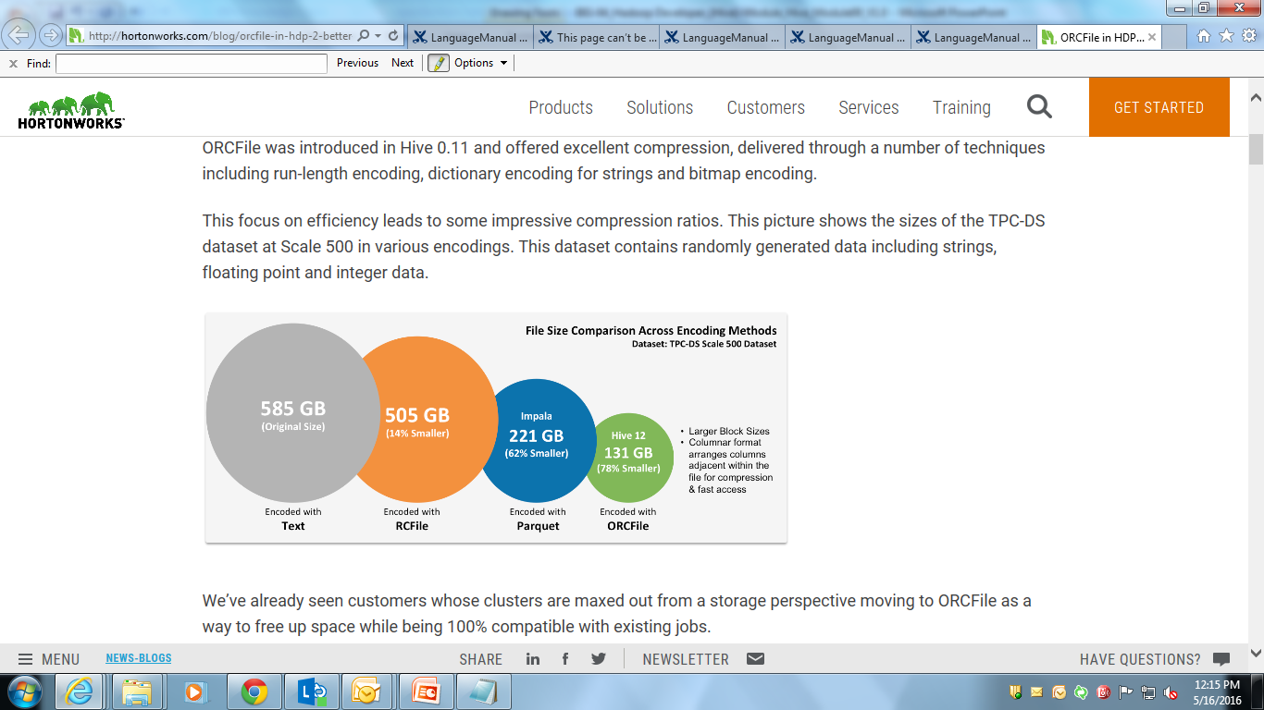
ORCFile format
Higher Compression Technique
ORCFile was introduced in Hive 0.11 and offered excellent compression, delivered through a number of techniques including run-length encoding, dictionary encoding for strings and bitmap encoding.
ORC reduces the size of the original data up to 75%. As a result the speed of data processing also increases. ORC shows better performance than Text, Sequence and RC file formats.
Source: http://hortonworks.com/blog/orcfile-in-hdp-2-better-compression-better-performance/

Slide 37
ORCFile format (cont..)
The Optimized Row Columnar (ORC) ﬁle format provides a highly eﬃcient way to store Hive data.
CREATE TABLE tablename (
...
) STORED AS ORC;
ALTER TABLE tablename SET FILEFORMAT ORC;
SET hive.default.fileformat=Orc
Notes:
Hive ORC Files
The Optimized Row Columnar (ORC) file format provides a highly efficient way to store Hive data. It was designed to overcome limitations of the other Hive file formats. Using ORC files improves performance when Hive is reading, writing, and processing data.
File formats in Hive are specified at the table level. Use the AS keyword and specify the
ORC file format:
CREATE TABLE tablename (
...
) AS ORC;
You can also modify the file format of an existing table:
ALTER TABLE tablename SET FILEFORMAT ORC;
You can also specify ORC as the default file format of new tables:
SET hive.default.fileformat=Orc
ORC files have three main components:
Stripe
Footer
Postscript
Here are the features of these components:
An ORC file is broken down into sets of rows called stripes.
The default stripe size is 250 MB. Large stripe sizes enable efficient reads of columns.
An ORC file contains a footer that contains the list of stripe locations.
The footer also contains column data like the count, min, max, and sum.
At the end of the file, the postscript holds compression parameters and the size of the compressed footer.

Slide 38
ORCFile format (cont..)
Using ORCFile or converting existing data to ORCFile is simple. To use it just add STORED AS orc to the end of your create table statements like this:
CREATE TABLE mytable ( ... ) STORED AS orc;
To convert existing data to ORCFile create a table with the same schema as the source table plus stored as orc, then you can use issue a query like:
Example:
INSERT INTO TABLE orctable SELECT * FROM oldtable;

Slide 39
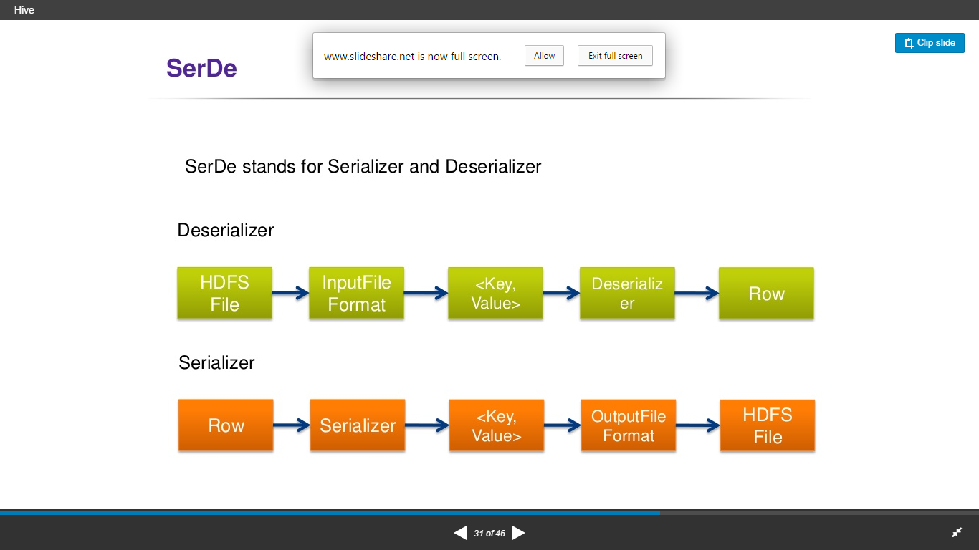
Storage - SerDe file format
SerDe stands for Serialize and De-serializer. Hive uses the SerDe interface for IO.
Notes:
Hive SerDes
SerDe is short for serializer/deserializer, and refers to how records and read in from a table (deserialized) and written back out to HDFS (serialized). Records can be stored in any custom format you want by writing Java classes, or you can use one of the several built-­‐in SerDes, including:
AvroSerDe: for reading and writing files using an Avro schema.
RegexSerDe: uses a regular expression to deserialize data.
ColumnarSerDe: for columnar based storage supported by RCFiles.
OrcSerDe: for reading and writing to ORC files.
There are quite a few built-­‐in SerDes, so check the documentation for a complete list.
NOTE: There are third-­‐party SerDes available as well, so do a search online before attempting to develop a custom SerDe that might already be available!
Using SerDes requires the ROW FORMAT SERDE clause. For example, the following table is for data stored in the Avro format:
CREATE TABLE names (fname string, lname string)
ROW FORMAT SERDE
'org.apache.hadoop.hive.serde2.RegexSerDe' WITH SERDEPROPERTIES (
"input.regex" = "([^ ]) . . [([^]]+)]",
"output.format.string" = "%1$s %2$s %3$s"
)
STORED AS RCFile;

Slide 40
Q & A
What is SerD in Hive?

Slide 41

Update, Delete, & INSERT in HIVE
INSERT

Slide 42
Update, Delete, & INSERT in HIVE (cont..)
Apache Hive provides a convenient SQL query engine and table abstraction for data stored in Hadoop. Hadoop is a batch processing system and Hadoop jobs tend to have high latency and incur substantial overheads in job submission and scheduling. Hive is not designed for online transaction processing and does not offer real-time queries and row level updates.
Hive uses Hadoop to provide highly scaleable bandwidth to the data.
Up until Hive 0.13, atomicity, consistency, and durability were provided at the partition level and did not support updates, deletes, or transaction isolation. This has prevented many desirable use cases, such as updating of dimension tables or doing data clean up.
But now Hive0.14 have implemented the standard SQL commands insert, update, and delete allowing users to insert new records as they become available, update changing dimension tables, repair incorrect data, and remove individual records. This also allows very low latency ingestion of streaming data from tools like Storm and Flume.
Limitation : BEGIN, COMMIT, and ROLLBACK are not yet supported. All language operations are auto-commit.

Slide 43
Update, Delete, & INSERT in HIVE (cont..)
UPDATE is available starting in Hive 0.14.
Updates can only be performed on tables that support ACID.
Partitioning columns cannot be updated.
Bucketing columns cannot be updated.
Upon successful completion of this operation the changes will be auto-committed
Standard Syntax:
UPDATE tablename SET column = value [, column = value ...] [WHERE expression]

Slide 44
Update, Delete, & INSERT in HIVE (cont..)
HIVE DELETE
DELETE is available starting in Hive 0.14.
Deletes can only be performed on tables that support ACID. See Hive Transactions for details.
Upon successful completion of this operation the changes will be auto-committed
Standard Syntax:
DELETE FROM tablename [WHERE expression]

Slide 45
Update, Delete, & INSERT in HIVE
HIVE INSERT
The INSERT...VALUES statement can be used to insert data into tables directly from SQL.
INSERT...VALUES is available starting in Hive 0.14.
Inserting values from SQL statements can only be performed on tables that support ACID
Syntax:
INSERT INTO TABLE tablename [PARTITION (partcol1=val1, partcol2=val2 ...)]
VALUES values_row [, values_row...]

Slide 46
Create Table As Select (CTAS)
Tables can also be created and populated by the results of a query in one create-table-as-select (CTAS) statement.
There are two parts in CTAS,
the SELECT part can be any SELECT statement supported by HiveQL.
The CREATE part of the CTAS takes the resulting schema from the SELECT part and creates the target table with other table properties such as the SerDe and storage format.
CTAS has these restrictions:
The target table cannot be a partitioned table.
The target table cannot be an external table.
The target table cannot be a list bucketing table.
Notes:
The table created by CTAS is atomic, meaning that the table is not seen by other users until all the query results are populated. So other users will either see the table with the complete results of the query or will not see the table at all.

Slide 47
CTAS - Syntax
CREATE TABLE new_key_value_store
ROW FORMAT SERDE "org.apache.hadoop.hive.serde2.columnar.ColumnarSerDe"
STORED AS RCFile
AS
SELECT (key % 1024) new_key, concat(key, value) key_value_pair
FROM key_value_store
SORT BY new_key, key_value_pair;

Slide 48
Difference between DELETE, TRUNCATE and DROP
DELETE : Delete particular row with where condition.
TRUNCATE: Truncate all the rows, which can not even be restored at all.
DROP: it drops the table along with the data associated with Hive Meta store.
If you had created a TABLE with EXTERNAL keyword then you can NOT remove all the rows because all data resides outside of Hive Meta store.
Syntax:
hive> TRUNCATE TABLE tablename;
Syntax – Drop Table
hive>DROP TABLE [IF EXISTS] table_name [PURGE];

Slide 49
Module-3 Outline
Hive's Join
Hive Sub queries
Using Distribute By & sort by
The OVER Clause
Partitioned Tables
Bucketed Hive table
Skewed Tables
Understanding Views
Deﬁning Views
Overview of Indexes

Slide 50
Module Outline (cont…)
Deﬁning Indexes
Using Windows
Hive Analytics Function

Slide 51
Apache Hive
Hive Module - III

Slide 52
Hive Join (cont..)
Hive uses three join strategies :
Type | Approach | Pros | Cons
Shuﬄe Join | Join keys are shuﬄed using MapReduce and joins are performed on the reduce side. | Works regardless of data size or layout. | Most resourceG intensive and slowest join type.
Map (Broadcast) Join | Small tables are loaded into memory in all nodes, mapper scans through the large table and joins. | Very fast, single scan through largest table. | All but one table must be small enough to ﬁt in RAM.
Sort; Merge; Bucket Join | Mappers take advantage of coGlocation of keys to do eﬃcient joins. | Very fast for tables of any size. | Data must be sorted and bucketed ahead of time.
Notes:
Hive Join Strategies
Some important concepts to understand when performing joins and laying out your Hive data:
Shuffle joins always work in the sense that if you cannot perform a more efficient type of join, two tables can always be joined using a shuffle join.
A map join is very efficient and ideal if one side of the join is a small enough dataset to fit into memory.
If a map join is not an option, then the next best option is a sort-­‐merge-­‐bucket join, which we will discuss in more detail.

Slide 53
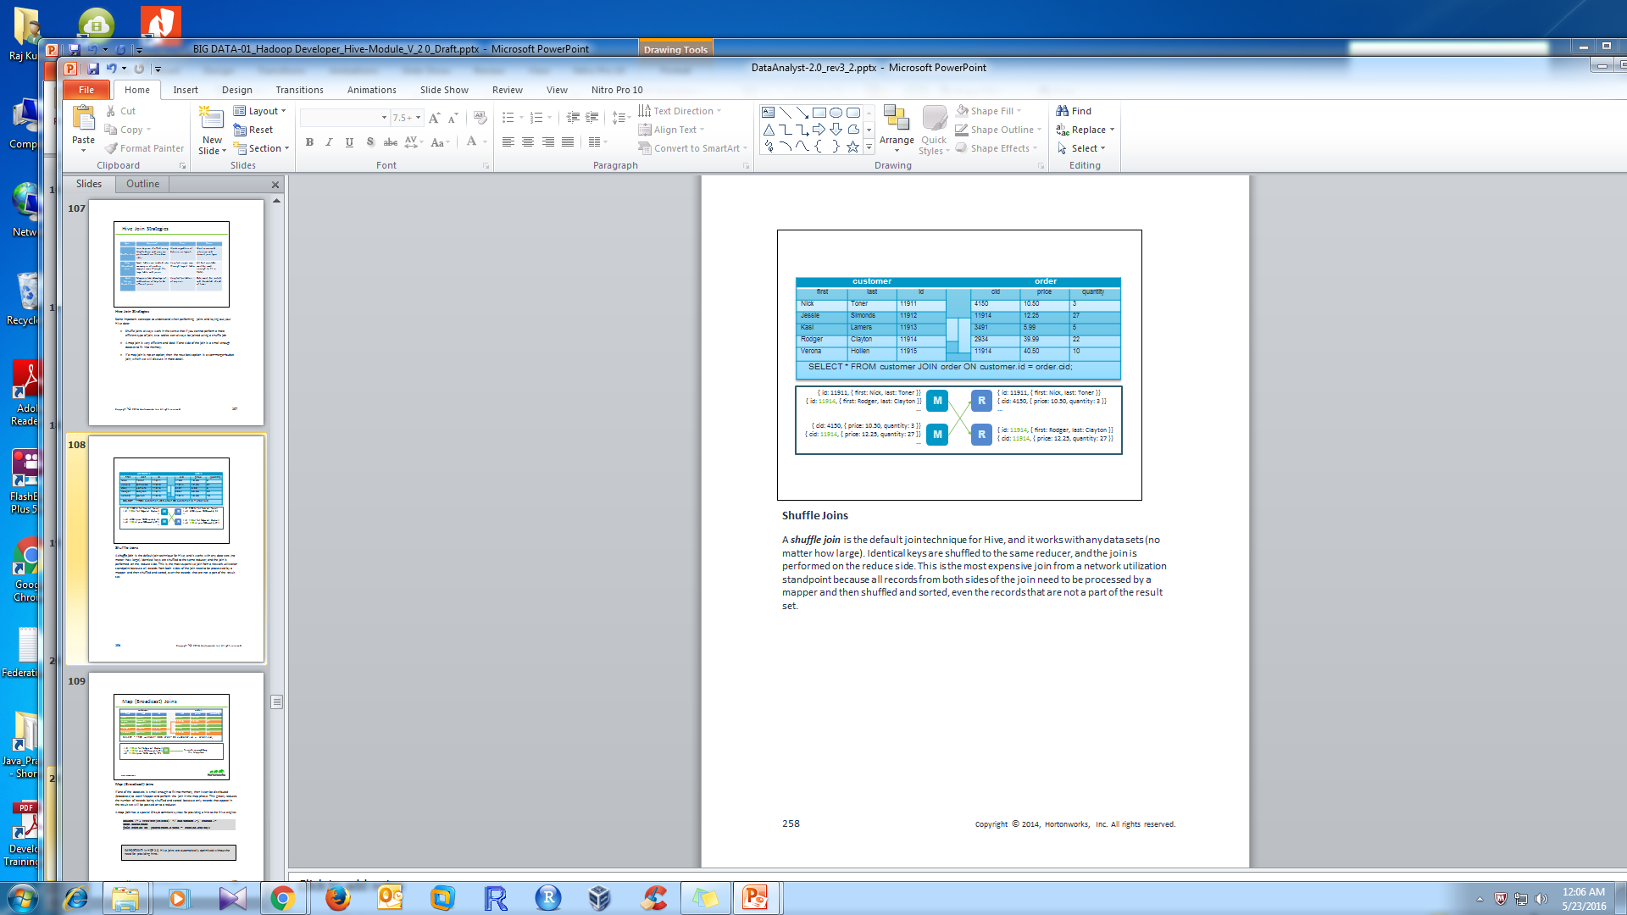
Hive Join (cont..)
Shuﬄe Joins
Notes:
Shuffle Joins
A shuffle join is the default join technique for Hive, and it works with any data sets (no matter how large). Identical keys are shuffled to the same reducer, and the join is performed on the reduce side. This is the most expensive join from a network utilization standpoint because all records from both sides of the join need to be processed by a mapper and then shuffled and sorted, even the records that are not a part of the result set.

Slide 54
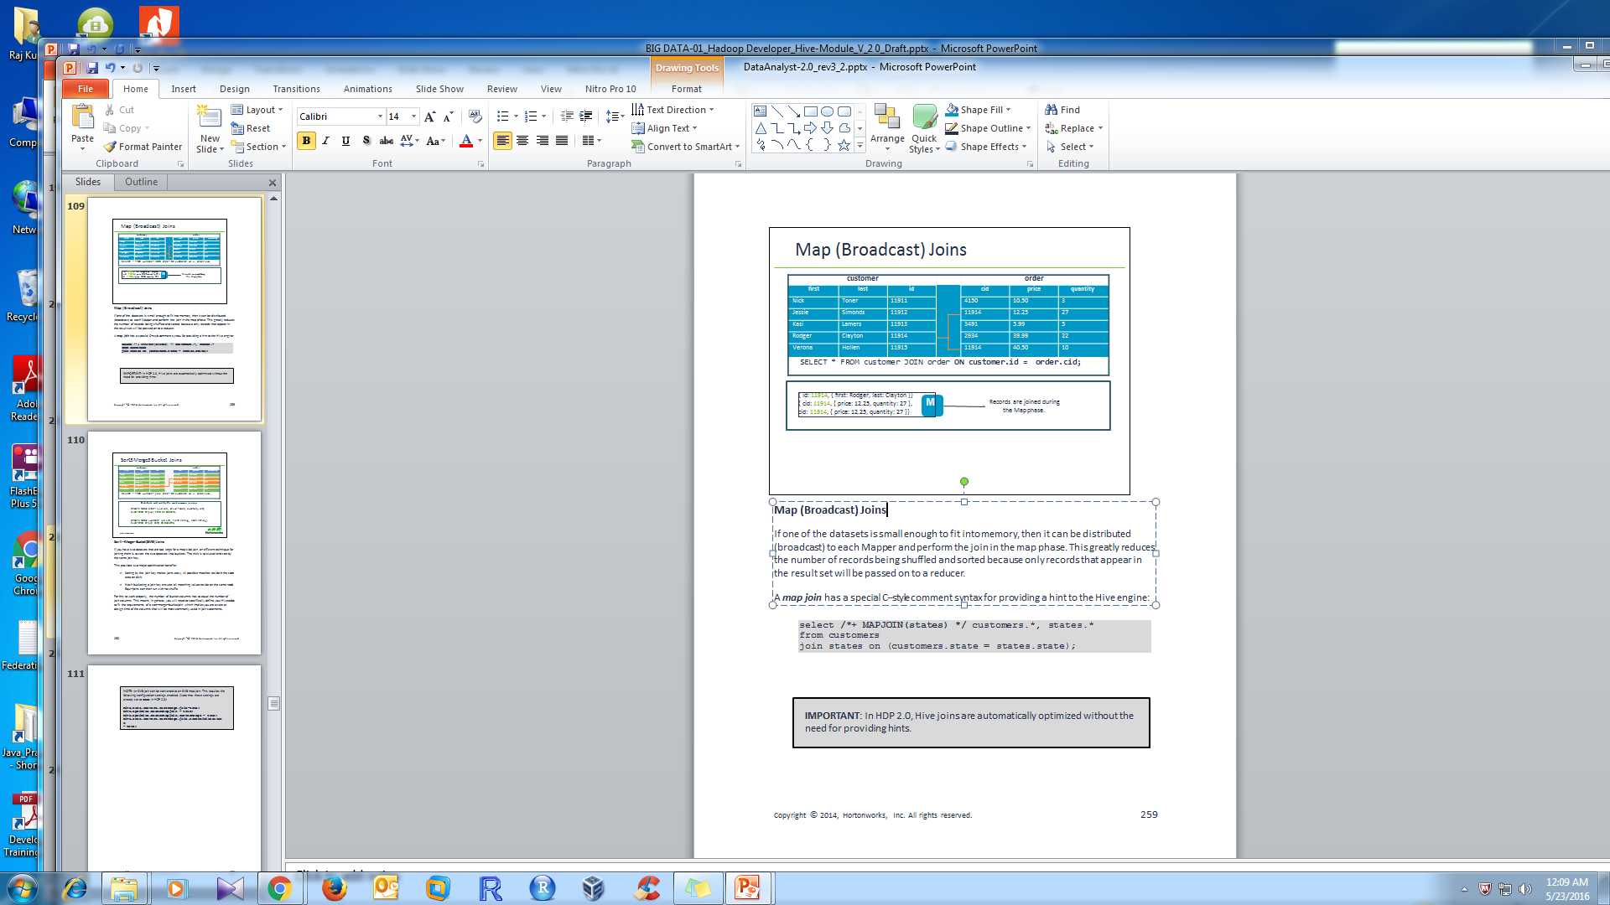
Hive Join (cont..)
Notes:
Map (Broadcast) Joins
If one of the datasets is small enough to fit into memory, then it can be distributed (broadcast) to each Mapper and perform the join in the map phase. This greatly reduces the number of records being shuffled and sorted because only records that appear in the result set will be passed on to a reducer.
A map join has a special C-­‐style comment syntax for providing a hint to the Hive engine:
select /*+ MAPJOIN(states) */ customers.*, states.*
from customers
join states on (customers.state = states.state);
IMPORTANT: In HDP 2.0, Hive joins are automatically optimized without the need for providing hints.

Slide 55
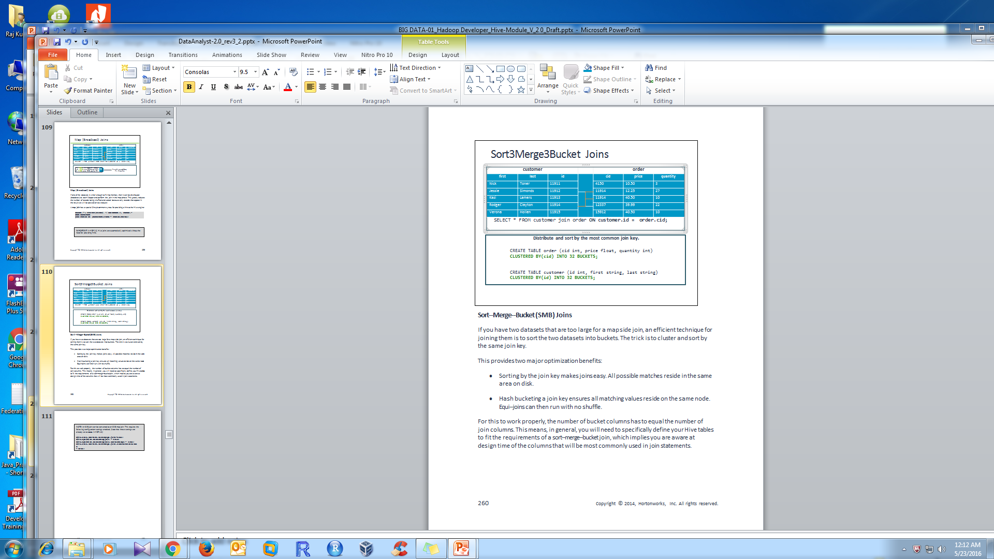
Hive Join (cont..)
Sort-Merge-Bucket Joins
Notes:
Sort-­‐Merge-­‐Bucket (SMB) Joins
If you have two datasets that are too large for a map side join, an efficient technique for joining them is to sort the two datasets into buckets. The trick is to cluster and sort by the same join key.
This provides two major optimization benefits:
Sorting by the join key makes joins easy. All possible matches reside in the same area on disk.
Hash bucketing a join key ensures all matching values reside on the same node. Equi-­‐joins can then run with no shuffle.
For this to work properly, the number of bucket columns has to equal the number of join columns. This means, in general, you will need to specifically define your Hive tables to fit the requirements of a sort-­‐merge-­‐bucket join, which implies you are aware at design time of the columns that will be most commonly used in join statements.
NOTE: An SMB join can be converted to an SMB map join. This requires the following configuration settings enabled. (Note that these settings are already set to true in HDP 2.0):
hive.auto.convert.sortmerge.join=true; hive.optimize.bucketmapjoin = true; hive.optimize.bucketmapjoin.sortedmerge = true; hive.auto.convert.sortmerge.join.noconditionaltask
= true;

Slide 56
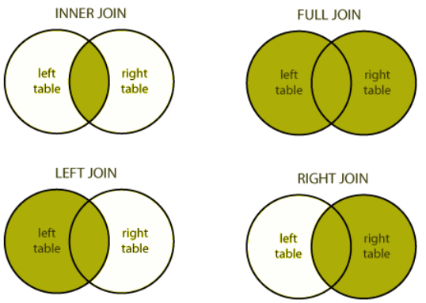
Hive Join

Slide 57
Hive Join (cont..)
JOIN clause is used to combine and retrieve the records from multiple tables.
JOIN is same as OUTER JOIN in SQL.
A JOIN condition is to be raised using the primary keys and foreign keys of the tables
There are following types of Join in Hive:
INNER JOIN .
LEFT JOIN (LEFT OUTER JOIN)
RIGHT JOIN (RIGHT OUTER JOIN)
FULL JOIN (FULL OUTER JOIN)

Slide 58
Hive Join (cont..)
INNER JOIN – Select records that have matching values in both tables.
Example:
hive> select c.id, c.name, o.order_date, o.amount from customers c inner join orders o ON (c.id = o.customer_id);
LEFT JOIN (LEFT OUTER JOIN) – returns all the values from the left table, plus the matched values from the right table, or NULL in case of no matching join predicate
Example:
hive> select c.id, c.name, o.order_date, o.amount from customers c left outer join
orders o ON (c.id = o.customer_id);

Slide 59
Hive Join (cont..)
RIGHT JOIN (RIGHT OUTER JOIN) A RIGHT JOIN returns all the values from the right table, plus the matched values from the left table, or NULL in case of no matching join predicate
Example:
hive> select c.id, c.name, o.order_date, o.amount from customers c left outer
join orders o ON (c.id = o.customer_id);
FULL JOIN (FULL OUTER JOIN) – Selects all records that match either left or right table records.
Example:
hive> select c.id, c.name, o.order_date, o.amount from customers c full outer
join orders o ON (c.id = o.customer_id);

Slide 60

Hive - Sub queries
A Subquery or Inner query or Nested query is a query within another HQL query and embedded within the WHERE clause.
A subquery is used to return data that will be used in the main query as a condition to further restrict the data to be retrieved.
Subqueries in the FROM Clause
Subqueries in the WHERE Clause

Slide 61
Hive - Sub queries (cont..)
Subqueries in the WHERE Clause
Hive supports Subqueries only in the FROM clause through Hive version 0.12
Example :
SELECT a.empid,a.ename, b.deptno FROM (SELECT * FROM emp) a JOIN (SELECT * FROM dept) b ON a.deptno = b.deptno;
Subqueries in the WHERE Clause
As of Hive 0.13 some types of Subqueries are supported in the WHERE clause
Example:
SELECT state, net_payments FROM transfer_payments WHERE
transfer_payments.year IN (SELECT year FROM us_census);

Slide 62
Sorting Data
Hive has two sorting clauses:
sort by: Hive uses the columns in SORT BY to sort the rows before feeding the rows to a reducer and data output is sorted per reducer
order by: a complete ordering of the data and It orders data at each of ‘N’ reducers. ORDER BY guarantees total ordering of data, but for that it has to be passed on to a single reducer, which is normally unacceptable and therefore in strict mode, hive makes it compulsory to use LIMIT with ORDER BY so that reducer doesn’t get overburdened.
Notes:
Sorting Data
HiveQL has two sorting clauses:
ORDER BY: a complete ordering of the data, which is accomplished by using a single reducer.
SORT BY: data output is sorted per reducer. The syntax for the two clauses looks like:
select * from table_name [order | sort] by column_name;
The syntax for both is identical, only the behavior is different. If there is more than one reducer, than sort by only provides a partial sorting of the data by reducer, but not a total ordering. Order by implements total ordering by using only one reducer.
IMPORTANT: The ORDER BY clause requires a LIMIT clause if the hive.mapred.mode property is set to strict. If the proprety is nonstrict then no LIMIT clause is required, but be aware that a single reducer with a large number of records can take an extremely long time to finish.

Slide 63
Using Distribute By & sort by
Hive uses the columns in Distribute By to distribute the rows among reducers. All rows with the same Distribute By columns will go to the same reducer.
Cluster By is a short-cut for both Distribute By and Sort By.
CLUSTER BY x ensures each of N reducers gets non-overlapping ranges, then sorts by those ranges at the reducers
SELECT * from dataset select * distribute by age;
SELECT * from dataset select * distribute by age sort by age;
SELECT * from dataset select * cluster by age;
Notes:
Using Distribute By
Hive uses the columns in distribute by to distribute the rows among reducers. In other words, all rows with the same distribute by columns will go to the same reducer. For example, suppose you have the following dataset with the schema (year, name, age) with year being the key:
1995 Dexter 24
2012 Carlos 33
………..
The following command demonstrates distribute by on the age column:
hive> from dataset select *
distribute by age;
Dexter and Emma will go to the same reducer even though they have a different key.
Similarly, Carlos and Troy will go to the same reducer.
The distribute by does not guarantee any type of clustering of the records. For example, a reducer might get:
1995 Troy 33
2000 Megan 20
Carlos 33
Carlos and Troy were sent to the same reducer, but they are not adjacent. You can use
sort by to cluster together records with the same distribute by column:
hive> from dataset select *
> distribute by age
sort by age;
The records with the same age will now appear together in the reducer’s output:
2000 Megan 20
1995 Troy 33
2012 Carlos 33
NOTE: If you use distribute by followed with a sort by on the same column, you can use cluster by and get the same result. For example, the following statement has the same result as the previous Hive statement above:
hive> from dataset select *
> cluster by age;

Slide 64
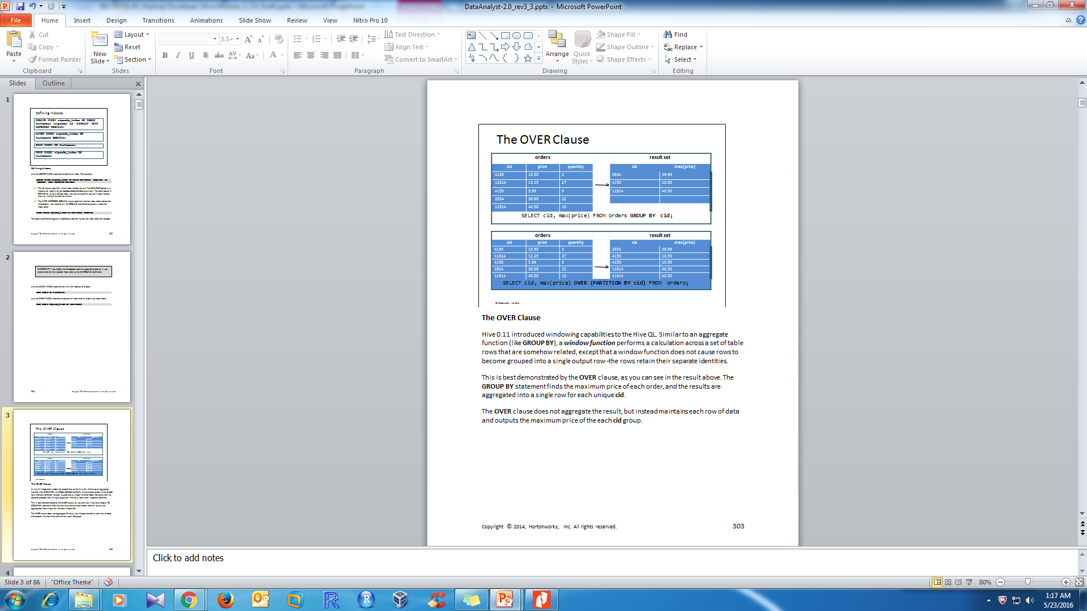
The OVER Clause
Notes:
The OVER Clause
Hive 0.11 introduced windowing capabilities to the Hive QL. Similar to an aggregate function (like GROUP BY), a window function performs a calculation across a set of table rows that are somehow related, except that a window function does not cause rows to become grouped into a single output row -­‐ the rows retain their separate identities.
This is best demonstrated by the OVER clause, as you can see in the result above. The GROUP BY statement finds the maximum price of each order, and the results are aggregated into a single row for each unique cid.
The OVER clause does not aggregate the result, but instead maintains each row of data and outputs the maximum price of the each cid group.

Slide 65
Partitioned Tables
Partitioned tables can be created using the PARTITIONED BY clause. A table
can have one or more partition columns and a separate data directory is
created for each distinct
Partitioning works both managed and external tables.
Usually Partitioning in Hive offers a way of segregating hive table data into multiple files/directories. But partitioning gives effective results when,
There are limited number of partitions
Comparatively equal sized partitions
Notes:
Example:
CREATE TABLE customer ( id INT, name STRING, address1 STRING, address2 STRING, city STRING, state STRING, zip STRING ) PARTITION BY ( REGION STRING, country STRING );
Note: If your Hive table is extremely large and table scans (i.e. queries without partition slicers) need to be blocked you can put Hive into strict mode using the command below. In this mode, when a querying that would result in a table scan is issued an error is thrown back to the user.
set hive.mapred.mode=strict

Slide 66
Bucketed Hive table
Hive Bucketing is nothing but another technique of decomposing data or decreasing the data into more manageable parts or equal parts
The Hive Partition can be further subdivided into Clusters or Buckets
Bucketing can be done along with Partitioning on Hive tables and even without partitioning
In Hive Partition we used PARTITIONED BY but in Hive Buckets we used CLUSTERED BY
Records with the same bucketed column will always be stored in the same bucket
Physically, each bucket is just a file in the table directory, and Bucket numbering is 1-based
and bucketed tables will create almost equally distributed data file parts
Advantages
Bucketed tables offer efficient sampling than by non-bucketed tables. With sampling, we can try out queries on a fraction of data for testing and debugging purpose when the original data sets are very huge As the data files are equal sized parts, map-side joins will be faster on bucketed tables than non-bucketed tables
Notes:
But this may not possible in all scenarios, like when are partitioning our tables based geographic locations like country, some bigger countries will have large partitions (ex: 4-5 countries itself contributing 70-80% of total data) where as small countries data will create small partitions (remaining all countries in the world may contribute to just 20-30 % of total data). So, In these cases Partitioning will not be ideal.
Features
Bucketing concept is based on (hashing function on the bucketed column) mod (by total number of buckets). The hash_function depends on the type of the bucketing column.
As the data files are equal sized parts, map-side joins will be faster on bucketed tables than non-bucketed tables. In Map-side join, a mapper processing a bucket of the left table knows that the matching rows in the right table will be in its corresponding bucket, so it only retrieves that bucket (which is a small fraction of all the data stored in the right table).
Similar to partitioning, bucketed tables provide faster query responses than non-bucketed tables.
Bucketing concept also provides the flexibility to keep the records in each bucket to be sorted by one or more columns. This makes map-side joins even more efficient, since the join of each bucket becomes an efficient merge-sort.
Limitations
Specifying bucketing doesn’t ensure that the table is properly populated. Data Loading into buckets needs to be handled by our-self.

Slide 67
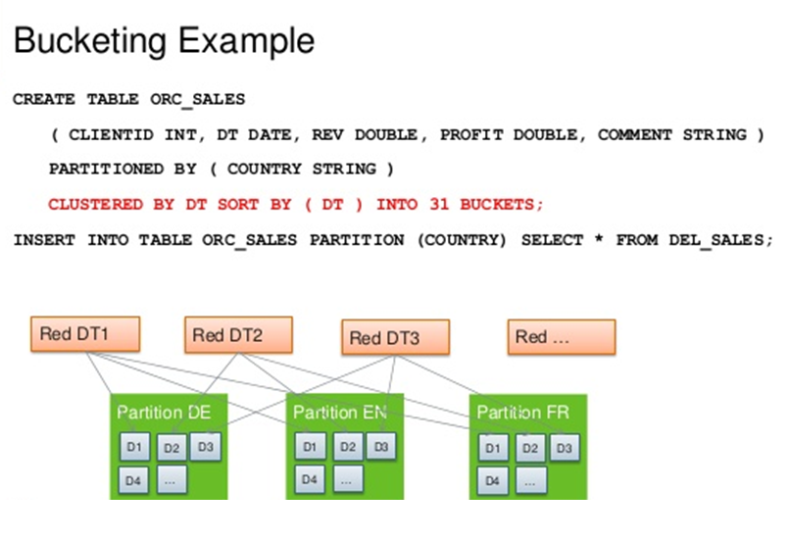
Bucketed Hive table (cont..)

Slide 68
Q & A
What is difference between bucketing and partitioning?

Slide 69
Skewed Tables
In Hive, skew refers to one or more columns in a table that
have values that appear very often
CREATE TABLE Customers ( id int,
username string, zip int
SKEWED BY (zip) ON (57701, 57702) STORED as
DIRECTORIES;
Notes:
Skewed Tables
In Hive, skew refers to one or more columns in a table that have values that appear very often. If you know a column is going to have heavy skew, you can specify this in the table’s schema:
CREATE TABLE Customers (
id int,
username string, zip int
)
SKEWED BY (zip) ON (57701, 57702) STORED as DIRECTORIES;
By specifying the values with heavy skew, Hive will split those out into separate files automatically and take this fact into account during queries so that it can skip whole files if possible.
In the Customers table above, records with a zip of 57701 or 57702 will be stored in separate files because the assumption is there will be a large number of customers in those two ZIP codes.

Slide 70
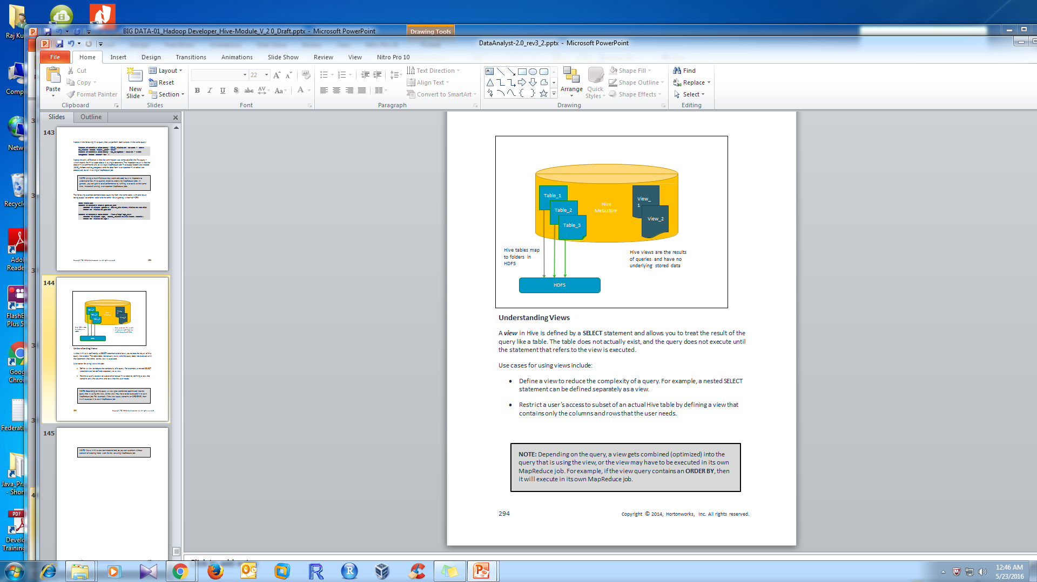
Understanding Views
Notes:
Understanding Views
A view in Hive is defined by a SELECT statement and allows you to treat the result of the query like a table. The table does not actually exist, and the query does not execute until the statement that refers to the view is executed.
Use cases for using views include:
Define a view to reduce the complexity of a query. For example, a nested SELECT statement can be defined separately as a view.
Restrict a user’s access to subset of an actual Hive table by defining a view that contains only the columns and rows that the user needs.
NOTE: Depending on the query, a view gets combined (optimized) into the query that is using the view, or the view may have to be executed in its own MapReduce job. For example, if the view query contains an ORDER BY, then it will execute in its own MapReduce job.
NOTE: Views in Hive are non-­‐materialized, so you can use them without concern of creating more work for the resulting MapReduce job.

Slide 71
Deﬁning Views
CREATE VIEW 2010_visitors AS SELECT fname, lname, time_of_arrival, info_comment FROM wh_visits WHERE cast(substring(time_of_arrival,6,4) AS int) >= 2010 AND cast(substring(time_of_arrival,6,4) AS int) < 2011;
Notes:
Defining Views
A view is defined using the CREATE VIEW statement. For example, the following Hive statement defines a view named 2010_visitors:
CREATE VIEW 2010_visitors AS
SELECT fname, lname, time_of_arrival, info_comment FROM wh_visits
WHERE
cast(substring(time_of_arrival,6,4) AS int) >= 2010
AND
cast(substring(time_of_arrival,6,4) AS int) < 2011;
The 2010_visitors is a view that represents people that visited the White House in the year 2010.
A view is not a table in Hive with actual data, but a view can be treated like a table. For example, you can run the DESCRIBE command on a view to see its schema:
hive> describe 2010_visitors; OK
fname string
lname string
time_of_arrival string
info_comment string
A view will also show up in your list of tables. For example, notice the output of the
SHOW TABLES command:
hive> show tables;
OK
2010_visitors wh_visits
Similar to a table, you can delete a view using the DROP VIEW command. For example:
DROP VIEW 2010_visitors;
NOTE: Views can also contain partitions, just like tables. This allows you to define views that behave exactly like your underlying tables, even tables that are partitioned.

Slide 72
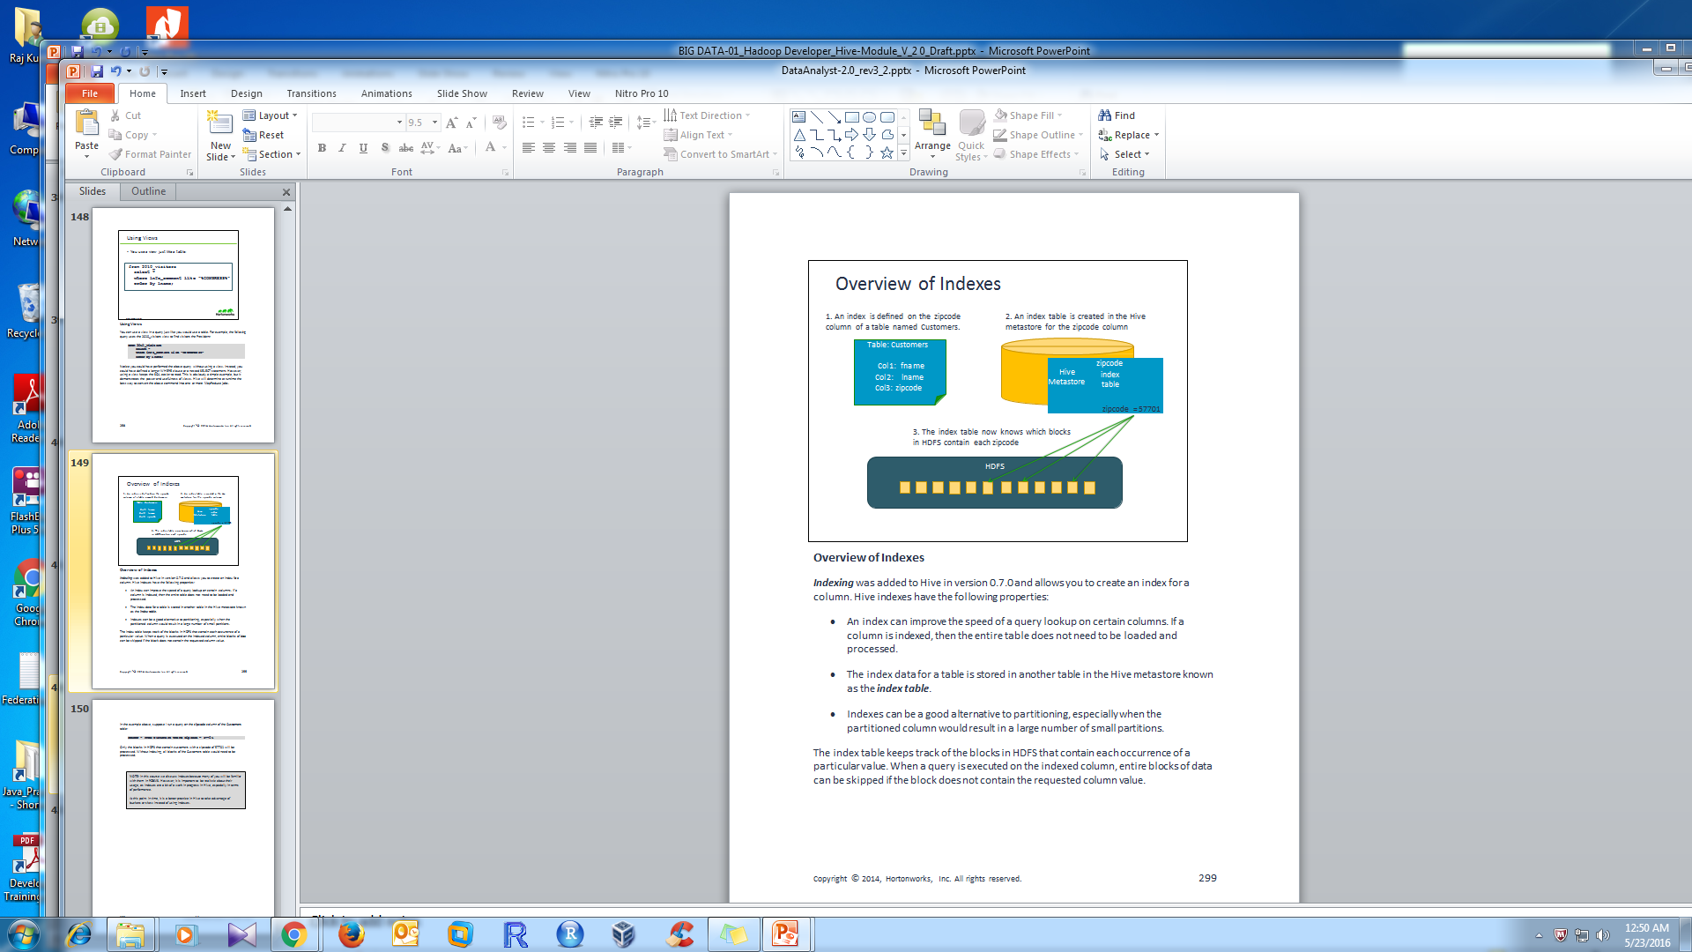
Overview of Indexes
Indexes are used to speed the search of data within tables
Hive indexes are limited to managed tables and cannot be used with external tables
Indexes can be partitioned (matching the partitions of the base table)
Indexes in Hive are not recommended
Notes:
Overview of Indexes
Indexing was added to Hive in version 0.7.0 and allows you to create an index for a column. Hive indexes have the following properties:
An index can improve the speed of a query lookup on certain columns. If a column is indexed, then the entire table does not need to be loaded and processed.
The index data for a table is stored in another table in the Hive metastore known as the index table.
Indexes can be a good alternative to partitioning, especially when the partitioned column would result in a large number of small partitions.
The index table keeps track of the blocks in HDFS that contain each occurrence of a particular value. When a query is executed on the indexed column, entire blocks of data can be skipped if the block does not contain the requested column value.
In the example above, suppose I run a query on the zipcode column of the Customers
table:
SELECT * FROM Customers WHERE zipcode = 57701
Only the blocks in HDFS that contain customers with a zipcode of 57701 will be processed. Without indexing, all blocks of the Customers table would need to be processed.
NOTE: In this course we discuss indexes because many of you will be familiar with them in RDBMS. However, it is important to be realistic about their usage, as indexes are a bit of a work in progress in Hive, especially in terms of performance.
At this point in time, it is a better practice in Hive to take advantage of buckets or skew instead of using indexes.

Slide 73
Deﬁning Indexes
CREATE INDEX zipcode_index ON TABLE Customers (zipcode) AS 'COMPACT' WITH DEFERRED REBUILD;
ALTER INDEX zipcode_index ON Customers REBUILD;
SHOW INDEX ON Customers;
DROP INDEX zipcode_index ON
Customers;
Notes:
Defining Indexes
Use the CREATE INDEX statement to define an index. For example:
CREATE INDEX zipcode_index ON TABLE Customers (zipcode) AS
'COMPACT' WITH DEFERRED REBUILD;
The AS clause specifies which index handler to use. The COMPACT option is a shortcut for specifying the CompactIndexHandler Java class. The other option is
BITMAP for using a bitmap index. You can also define your own index handler
class by writing a custom Java class.
The WITH DEFERRED REBUILD clause specifies that the index table not be built immediately. You need to run the REBUILD command to actually create the index table:
ALTER INDEX zipcode_index ON Customers REBUILD;
The above command triggers a MapReduce job that builds the index table for zipcode.
IMPORTANT: If you modify the Customers table by appending data to it, you need to rebuild the zipcode index table using the REBUILD command.
Use the SHOW INDEX statement to view the indexes of a table:
Use the DROP INDEX statement to delete an index and its underlying index table:
DROP INDEX zipcode_index ON Customers;

Slide 74
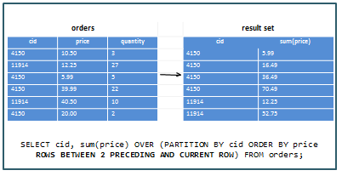
Using Windows
Notes:
Using Windows
The OVER clause allows you to define a window over which to perform a specific calculation. For example, the following Hive statement computes the sum of each order, but the sum is not computed over all prices in an order. Instead, the sum is computed over a window that includes the current row and the two preceding rows, as ordered by the price column.
SELECT cid, sum(price) OVER (PARTITION BY cid ORDER BY
price ROWS BETWEEN 2 PRECEDING AND CURRENT ROW) FROM
orders;
Study the output carefully and see if you verify that the result is what you expected based on the query.
The FOLLOWING statement is used to specify rows after the current row:
SELECT cid, sum(price) OVER (PARTITION BY cid ORDER BY
price ROWS BETWEEN 2 PRECEDING AND 3 FOLLOWING) FROM
orders;
Use the UNBOUNDED statement to specify all prior or following rows:
SELECT cid, sum(price) OVER (PARTITION BY cid ORDER BY
price ROWS BETWEEN UNBOUNDED PRECEDING AND CURRENT ROW)
FROM orders;
NOTE: Hive window functions also include the LEAD and LAG functions for specifying the number of rows to lead ahead or lag behind in the window. Their usage is identical to SQL-­‐92.

Slide 75
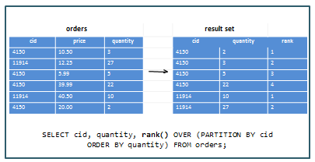
Hive Analytics Function
Notes:
Hive Analytics Functions
Hive 0.11 also added the following SQL standard analytics functions:
RANK: Returns the rank of each row within the partition of a result set.
DENSE_RANK: Returns the rank of rows within the partition of a result set, without any gaps in the ranking.
PERCENT_RANK: Calculates the relative rank of a row within a group of rows.
ROW_NUMBER: Returns the sequential number of a row within a partition of a result set.
CUME_DIST: For a row r, the CUME_DIST of r is the number of rows with values lower than or equal to the value of r, divided by the number of rows evaluated in the partition.
NTILE: Distributes the rows in an ordered partition into a specified number of groups. For each row, NTILE returns the number of the group to which the row belongs.

Slide 76
Module-4 Outline
Hive Optimization
Hive query using Tez Execution Engine
Run a Hive query using vectorization
Run a Hive query using CBO
User-Defined Functions (UDFs)

Slide 77
Apache Hive - Optimization
Hive on Hadoop makes data processing so straightforward and scalable but
Well designed tables and queries can greatly improve speed and reduce processing cost.
There are broadly three areas in which we can optimize Hive utilization are:
Data Layout (Partitions and Buckets)
Data Sampling (Bucket and Block sampling)
Data Processing (Bucket Map Join and Parallel execution)

Slide 78
Hive Optimization
Below are some helpful design tips for improving the speed of Hive queries.
Divide data amongst diﬀerent ﬁles which can be pruned out by using partitions, buckets and skews
Sort data ahead of time to simplify joins
Use the ORC ﬁle format
Sort and Bucket on common join keys
Use map (broadcast) joins whenever possible
Increase the replication factor for hot data (which reduces latency)
Use CBO
Use Vectorization
Take advantage of Tez

Slide 79
Hive Optimization (cont..)
Table Partitions : Cloudera recommends keeping table partitions below two or three thousand for optimal performance.
When a hive query has to reference more than a few thousand partitions, performance can suffer. Multiple queries must be run against the Hive Metastore database to retrieve and update these partitions and HDFS must move these files around.
For the best performance, design your tables to partition on fewer columns or to have less granular time frames, for example by day instead of hourly. Also, hone your queries to use only a subset of a table's partitions
Note : Hive has a special file called the .hiverc file that gets executed each time you launch a Hive shell. This makes the .hiverc file a great place for adding custom configuration settings that you use all the time, or loading JAR files that contain frequently-­‐used UDFs. The file is saved in the Hive conf directory, which is /etc/hive/conf for an HDP installation.

Slide 80
Hive Optimization (cont..)
mapreduce.input.ﬁleinpu@ormat.split.maxsize
mapreduce.input.ﬁleinpu@ormat.split.minsize
mapreduce.tasks.io.sort.mb
In addition, set the important join and bucket properties to true in hive)site.xml or by using the set command.
Notes:
Hive Query Tunings
Hive has a lot of parameters that can be set globally in hive-­‐site.xml or at the script level using the set command. Here are some of the more important parameters to improve the performance of your Hive queries:
mapreduce.input.fileinputformat.split.maxsize and mapreduce.input.fileinputformat.split.minsize: if the min is too large, you will have too few mappers. If the max is too small, you will have too many mappers.
mapreduce.tasks.io.sort.mb: increase this value to avoid disk spills. Set the following properties all the time:
hive.optimize.mapjoin.mapreduce=true;
hive.optimize.bucketmapjoin=true; hive.optimize.bucketmapjoin.sortedmerge=true; hive.auto.convert.join=true; hive.auto.convert.sortmerge.join=true; hive.auto.convert.sortmerge.join.noconditionaltask=true;

Slide 81
Hive Optimization (cont..)
Hive Query Tunings
Hive has a lot of parameters that can be set globally in hive-­‐site.xml or at the script level using the set command. Here are some of the more important parameters to improve the performance of your Hive queries:
mapreduce.input.fileinputformat.split.maxsize and mapreduce.input.fileinputformat.split.minsize: if the min is too large, you will have too few mappers. If the max is too small, you will have too many mappers.
mapreduce.tasks.io.sort.mb: increase this value to avoid disk spills. Set the following properties all the time:

Slide 82

Hive query using Tez Execution Engine

Slide 83
Hive query using Tez Execution Engine (cont..)
Hive can use the Apache Tez execution engine instead of the venerable Map-reduce engine
it’s not turned on by default in your environment
To Enable Tez model use :
hive > set hive.execution.engine=tez;
Limitation of Tez
Tez does not support the following actions:
Index creation
Skew joins

Slide 84
Hive on Spark
Hive traditionally uses MapReduce behind the scenes to parallelize the work, and perform the low-level steps of processing a SQL statement such as sorting and filtering. Hive can also use Spark as the underlying computation and parallelization engine
Hive on Spark provides better performance than Hive on MapReduce while offering the same features. Running Hive on Spark requires no changes to user queries
Hive user-defined functions (UDFs) are fully supported, and most performance-related configurations work with the same semantics
To configure Hive to run on Spark do both of the following steps:
Configure the Hive client to use the Spark execution engine
set hive.execution.engine=spark;
Identify the Spark service that Hive uses. Cloudera Manager automatically sets this to the configured MapReduce

Slide 85
Run a Hive query using vectorization
Hive Vectorization
Vectorization allows Hive to process a batch of rows together as a unit instead of processing one row at a time. Each batch consists of a column vector which is usually an array of primitive types. Operations are performed on the entire column vector, which improves the instruction pipelines and cache usage.
It perform in batches of 1024 rows at once instead of single row each time.
Vectorized query execution improves performance of operations like scans, aggregations, filters and joins.
Introduced in Hive 0.13, this feature significantly improves query execution time, and is easily enabled with two parameters settings:
set hive.vectorized.execution.enabled = true; set hive.vectorized.execution.reduce.enabled = true;

Slide 86
Run a Hive query using CBO
Cost-based optimization (CBO), performs optimizations based on query cost.
To use CBO set the following parameters at the beginning of your query:
hive>set hive.cbo.enable=true;
hive>set hive.compute.query.using.stats=true;
hive>set hive.stats.fetch.column.stats=true;
hive>set hive.stats.fetch.partition.stats=true;

Slide 87
Creating User-Defined Functions
Hive supports manipulation of data via user-created functions
Example:
INSERT OVERWRITE TABLE u_data_new
SELECT TRANSFORM (userid, movieid, rating, unixtime)
USING 'python weekday_mapper.py‘ AS (userid, movieid, rating, weekday)
FROM u_data;
Notes:
Invoking a Hive UDF
Similar to Pig, Hive has the ability to use User-­‐Defined Functions written in Java to perform computations that would otherwise be difficult (or impossible) to perform using the built-­‐in Hive functions and SQL commands.
To invoke a UDF from within a Hive script, you need to:
Register the JAR file that contains the UDF class, and
Define an alias for the function using the CREATE TEMPORARY FUNCTION command.
For example, the following Hive commands demonstrate how to invoke the
ComputeShipping UDF defined above:
ADD JAR /myapp/lib/myhiveudfs.jar;
CREATE TEMPORARY FUNCTION ComputeShipping AS 'hiveudfs.ComputeShipping';
FROM orders SELECT address, description,
ComputeShipping(zip, weight);

Slide 88
Hive Use Cases
Hive is a petabyte-scale data warehouse system built on the Hadoop platform, it is a good choice for environments experiencing phenomenal growth in data volume. The underlying MapReduce interface with HDFS is hard to program directly, but Hive provides an SQL interface, making it possible to use existing programming skills to perform data preparation.
Hive on MapReduce or Spark is best-suited for batch data preparation or ETL:
You must run scheduled batch jobs with very large ETL sorts with joins to prepare data for Hadoop. Most data served to BI users in Impala is prepared by ETL developers using Hive
You run data transfer or conversion jobs that take many hours. With Hive, if a problem occurs partway through such a job, it recovers and continues.
You receive or provide data in diverse formats, where the Hive SerDes and variety of UDFs make it convenient to ingest and convert the data. Typically, the final stage of the ETL process with Hive might be to a high-performance, widely supported format such as Parquet.
Notes:
Invoking a Hive UDF
Similar to Pig, Hive has the ability to use User-­‐Defined Functions written in Java to perform computations that would otherwise be difficult (or impossible) to perform using the built-­‐in Hive functions and SQL commands.
To invoke a UDF from within a Hive script, you need to:
Register the JAR file that contains the UDF class, and
Define an alias for the function using the CREATE TEMPORARY FUNCTION command.
For example, the following Hive commands demonstrate how to invoke the
ComputeShipping UDF defined above:
ADD JAR /myapp/lib/myhiveudfs.jar;
CREATE TEMPORARY FUNCTION ComputeShipping AS 'hiveudfs.ComputeShipping';
FROM orders SELECT address, description,
ComputeShipping(zip, weight);

Slide 89
Q & A

Slide 90
Thank You
Review Date | 25-May-2016
Version | 1.0
Next Review Due | 15-July-2016

